Slide 1
UML Class Diagrams
Chapter 16
Applying UML and Patterns
Craig Larman

Slide 2
Objective
Create design class diagrams (DCDs).
Identify the classes, methods, and associations to show in a DCD.

Slide 3
Class Diagrams
The UML has notation for showing design details in static structure.
  Class diagrams
The definition of design class diagrams occurs within the design phase.
  The UML does not specifically define design class diagram.
  It is a design view on SW entities, rather than an analytical view on domain concepts.

Slide 4
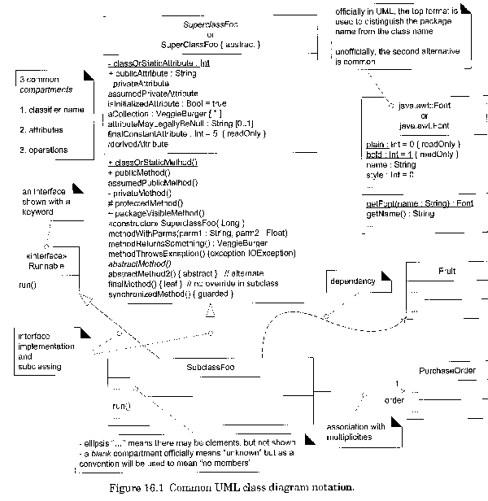
Text –
Figure 16-1
DCD
Summary

Slide 5
Design Class Diagrams
The creation of design class diagrams is dependent upon the prior creation of:
Interaction diagrams
  Identifies the SW classes that participate in
  the solution, plus the methods of classes.
Conceptual model
  Adds detail to the class definitions.

Slide 6
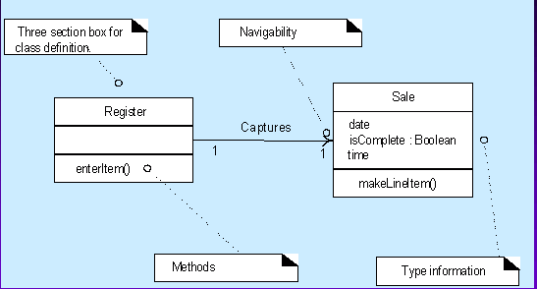
Example of a DCD.

Slide 7
As we can see….
A design class diagram illustrates the specifications for SW classes and interfaces.
Typical information included:
  Classes, associations, and attributes
  Interfaces, with their operations and constants
  Methods
  Attribute type information
  Navigability
  Dependencies

Slide 8
How to make a DCD.
Identify all the classes participating in the SW solution by analyzing the interaction diagrams.
Draw them in a class diagram.
Duplicate the attributes from the associated concepts in the conceptual model.
Add method names by analyzing the interaction diagrams.
Add type information to the attributes and methods.

Slide 9
Continue…
Add the associations necessary to support the required attribute visibility.
Add navigability arrows to the associations to indicate the direction of attribute visibility.
Add dependency relationship lines to indicate non-attribute visibility.

Slide 10
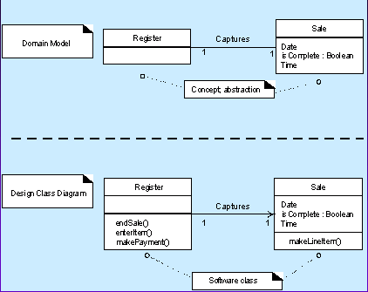
Domain model Vs. DCD

Slide 11
Creating the NextGen POS DCD.
Identify SW classes and illustrate them.
Register Sale
ProductCatalog ProductSpecification
Store SalesLineItem
Payment

Slide 12
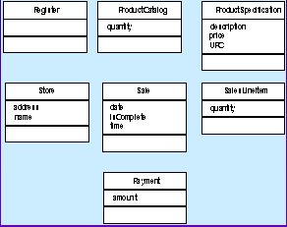
Software Classes
Draw a class diagram for these classes.
Include the attributes previously identified in the domain model.

Slide 13
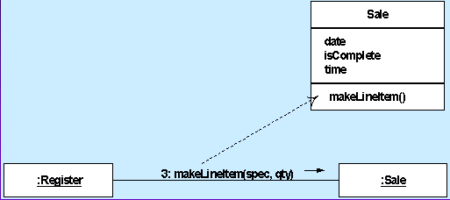
Add method name
Method names from interaction diagrams

Slide 14
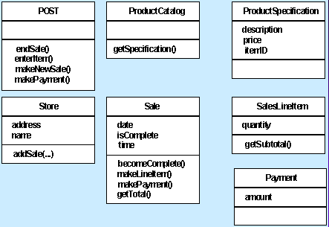
Methods……

Slide 15
Method names: issues
The following special issues must be considered with respect to method names:
  Interpretation of the create() message.
  Depiction of accessing methods.
  Interpretation of messages to multi-objects.
  Language-dependent syntax.

Slide 16
Method names: create
The create message is the UML language independent form to indicate instantiation and initialization.
When translating the design to an OOPL it must be expressed in terms of its idioms for instantiation and initialization.

Slide 17
Method names:
Accessing methods
Accessing methods are those which retrieve (accessor method - get) or set (mutator method) attributes.
It is common idiom to have an accessor and mutator for each attribute, and to declare all attribute private (to enforce encapsulation).

Slide 18
Method names:
Multi-objects
A message to a multi-object is interpreted as a message to the container/collection object.

Slide 19
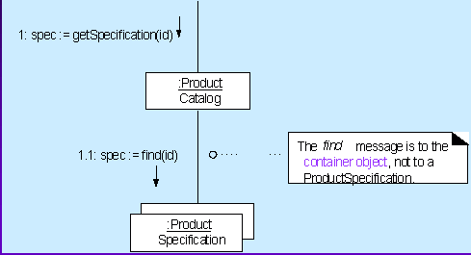
Message to a Multi-objects
Java’s map, C++’s map, Smalltalk’s dictionary.

Slide 20
Method names:
Language dependent syntax
The basic UML format for methods:
methodName(parameterList)

Slide 21
Adding more type information
The type of the attributes, method parameters, and method return values may all optionally be shown.

Slide 22
Continue…..
The design class diagram should be created by considering the audience.
  If it is being created in a CASE tool with automatic code generation, full and exhaustive details are necessary.
  If it is being created for SW developers to read, exhaustive low-level detail may adversely effect the noise-to-value ratio.

Slide 23
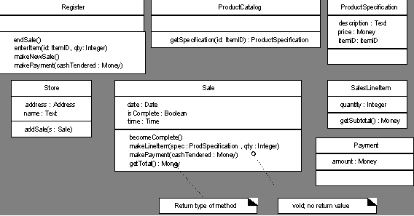
Continue…

Slide 24
Adding associations and navigability
Navigability is a property of the role which indicates that it is possible to navigate
uni-directionally across the association from objects of the source to target class.
Navigability implies visibility.
Most, if not all, associations in design-oriented class diagrams should be adorned with the necessary navigability arrows.

Slide 25
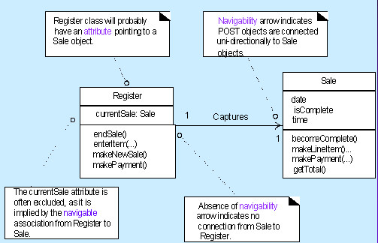
Showing navigability, or attribute visibility.

Slide 26
Association with navigability
Define an association with a navigability adornment from A to B:
  A sends a message to B.
  A creates an instance B.
  A needs to maintain a connection to B.

Slide 27
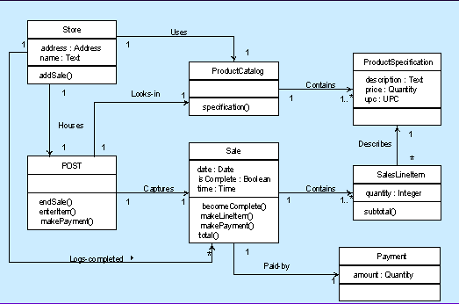
Associations with navigability adornments

Slide 28
Adding dependency relationships
Dependency relationship indicates that one element (of any kind, including classes, use cases, and so on) has knowledge of another element.
  A dependency is a using relationship that states a change in specification of one thing may affect another thing that uses it, but not necessarily the reverse.

Slide 29
Continue…
The dependency relationship is useful to depict non-attribute visibility between classes.
  Parameters
  Global or local visibility
  A dashed arrow line
  A dashed directed line

Slide 30
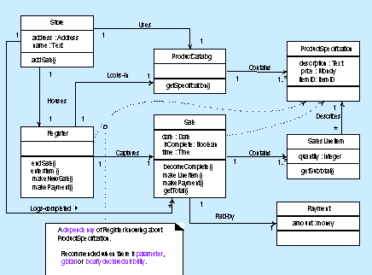
Dependency relationships non-attribute visibility

Slide 31
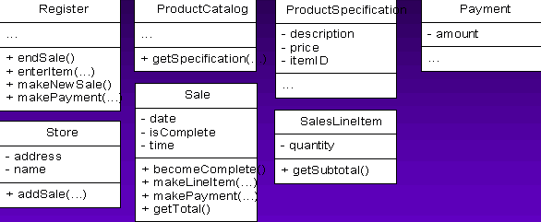
Member details in the POS class diagram

Slide 32
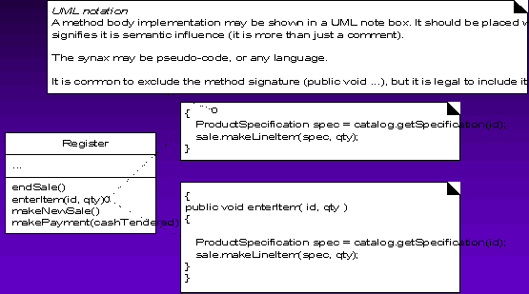
Notation for method bodies in DCDs.

Slide 33
Interfaces
The UML has several ways to show interface implementations. Since both the socket line notation and the dependency line notation used curved lines not common in drawing tools, most people use a dependency arrow and the «interface» stereotype.

Slide 34
Interface Example
«interface»
Timer
getTime()
Clock1
getTime( )

Slide 35
UML stereotypes
UML uses stereotypes encapsulated in guillemots (« and », not << and >> ) to extend many diagram symbols.
Guillemots can be found in the latin-1 symbol set in Windows Insert Symbol command)
Examples: «interface» «extends» «includes» «actor» «creates»

Slide 36
Association
An association is a structural relationship that specifies that objects of one thing are connected to objects of another.

Slide 37
Navigation
Navigability is a property of the role which indicates that it is possible to navigate uni-directionally across the association from objects of the source to target class.
Navigability implies visibility.

Slide 38
Dependency
A dependency is a using relationship, specifying that a change in the specification of one thing may affect another thing that uses it.

Slide 39
Generalization
A generalization is a relationship between a general thing (called the super class or parent) and a more specific kind of that thing (called the subclass or child).
is-a-kind-of relationship.

Slide 40
Aggregation
Whole/part relationship
Has-a relationship

Slide 41
Phases
Inception
  The Design Model and DCDs will not
  usually be started until elaboration because it
  involves detailed design decisions, which are
  premature during inception.

Slide 42
Continue…
Elaboration
  During this phase, DCDs will accompany the UC realization interaction diagrams; they may be created for the most architecturally significant classes of the design.
  CASE tools can reverse-engineer (generate) DCDs from source code.

Slide 43
Continue…
Construction
  DCDs will continue to be generated from the source code as an aid in visualizing the static structure of the system.

Slide 44
Aggregation, composition
Qualified association
Association class
Singleton class

